Slide 1

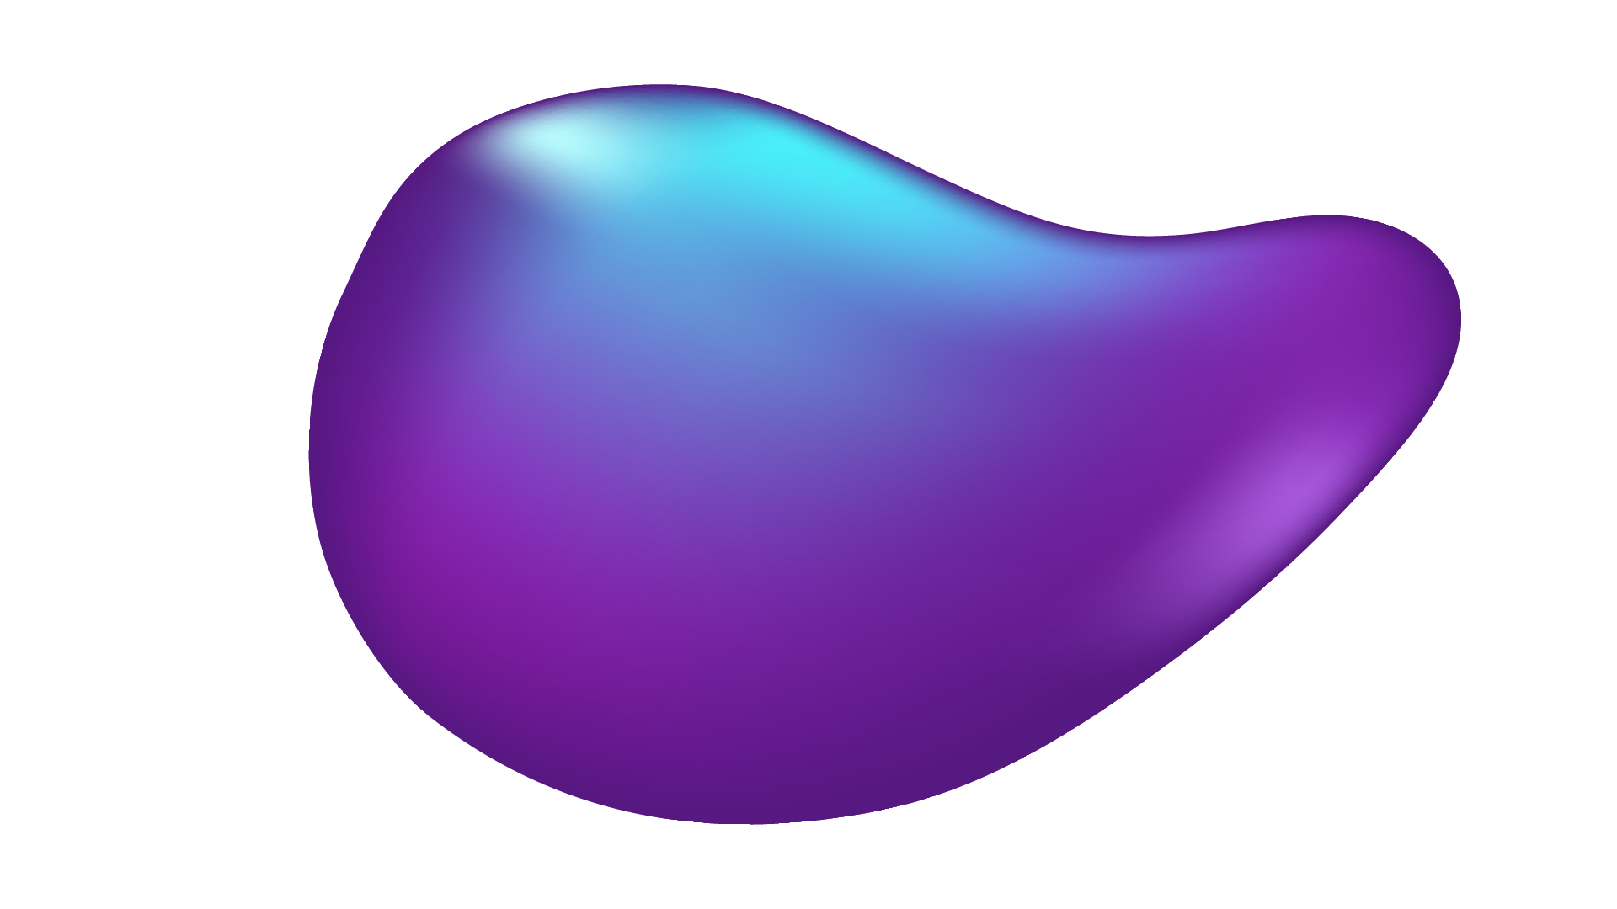
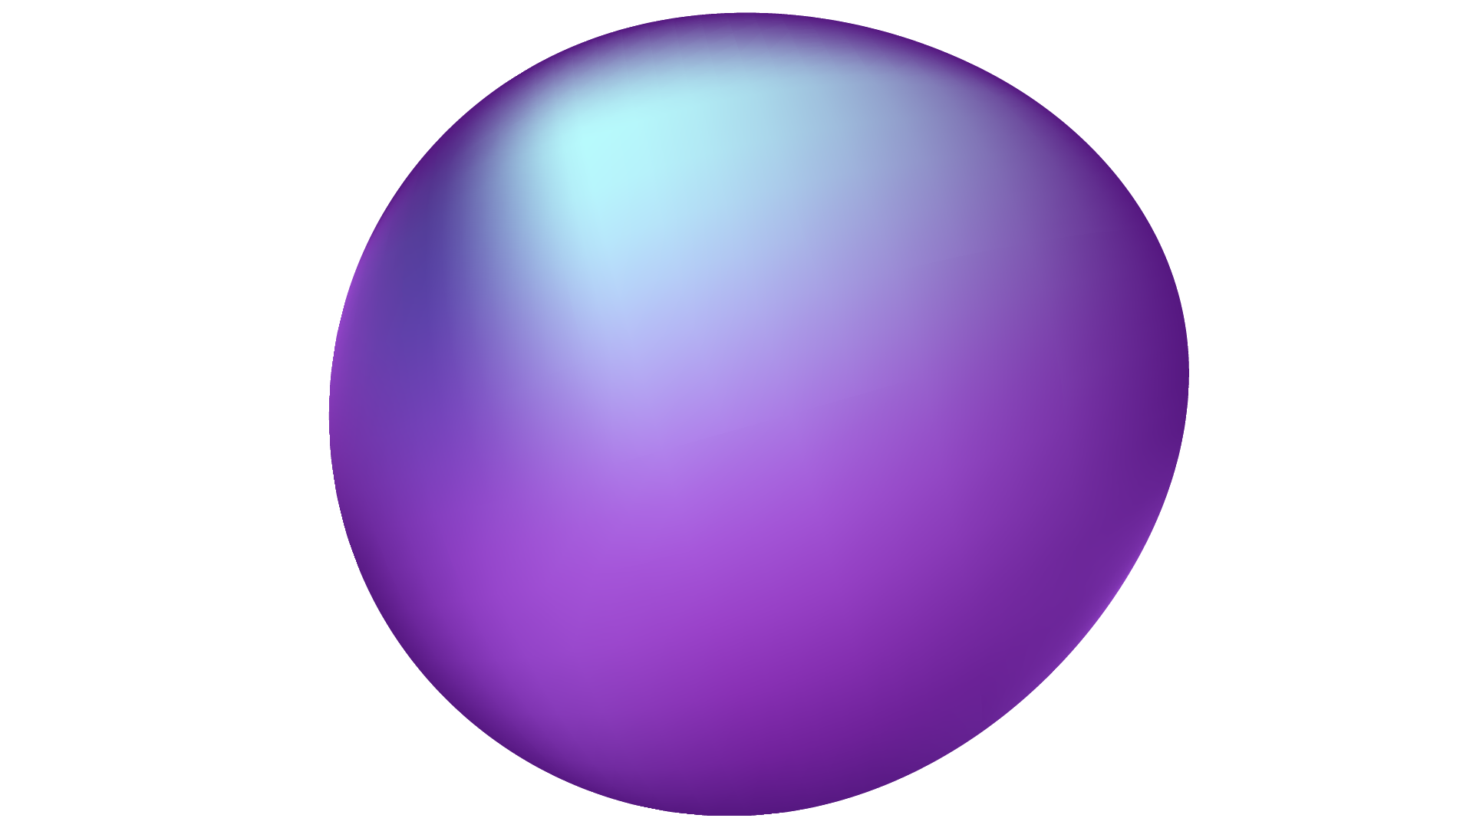
AI BASEDDIABETES-PREDICTION PHASE-5

Slide 2
Problem Statement:-
If you have diabetes, your pancreas either produces too little insulin or none at all. The insulin can’t be used effectively. This allows blood glucose levels to rise while the rest of your cells are deprived of much-needed energy. This can lead to a wide variety of problems affecting nearly every major body system.
Diabetes mellitus is a metabolic disease that causes high blood sugar. Your body either doesn’t make enough insulin or can’t effectively use the insulin it makes.
The hormone insulin moves sugar from the blood into your cells to be stored or used for energy.
If this malfunctions, you may have diabetes.
untreated high blood sugar from diabetes can damage your nerves, eyes, kidneys, and other organs. But educating yourself about diabetes and taking steps to prevent or manage it can help you protect your health.

Slide 3
OVERALL DESIGN
Hyperparameter Tuning
Start
Machine learing Algorithm(SVM,
XGBoost)
K-fold cross validation test
Training set
EHRs
Training model
Data preprocessing
Test set
Perfomance Evaluation
K-fold cross validation result
End
Processed Dataset

Slide 4
System Archietecture:
The system architecture for the Diabetes Management System presented below in Figure 1 is the conceptual model that defines the structure, behavioural interactions, and multiple system views that underpins the system development.
It presents the formal descriptions of the systems captured graphically that supports reasoning, and the submodules developed as well as the dataflows between the developed modules.
It presents the components of the system architecture, which comprises:
(1) Diabetes Intelligent Meal Recommender Module.
(2) Educational Module for Diabetics with Food Recognition Engine.
(3) Activity Tracking Module.
(4) Medication Reminder Module.

Slide 5
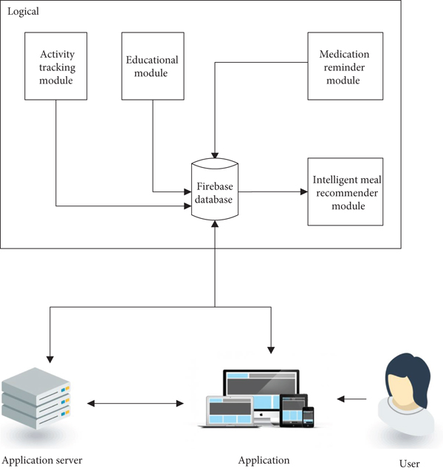

Slide 6
The architecture of a diabetes prediction system typically consIst of several components that work together to collect, process, and predict diabetes risk. Below is a simplified overview of a typical architecture for such a system:
1. Data Collection:o Electronic Health Records (EHRS): Patient data is often collected from electronic health records information medical history.
2. Feature Selection: Machine learning models are used to analyze these datasets. Feature selection techniques help identify the most relevant factors for predicting diabetes risk. Innovations may involve using deep learning models, featureengineering, or genetic markers.
3. Model Development: Various machine learning algorithms, such as logistic regression, decision trees, random forests, and neural networks, are employed to create predictive models. Innovations include the use of deep learning models like convolutional neural networks (CNNs) or recurrent neural networks (RNNs) for improved accuracy.

Slide 7
Coding:1
import pandas as pd
import numpy as np
import matplotlib.pyplot as plt
import seaborn as sns
import warnings
from sklearn.model_selection import train_test_split
from sklearn.preprocessing import StandardScaler
from sklearn import svm
from sklearn.metrics import classification_report
from sklearn.metrics import confusion_matrix
from sklearn.metrics import ConfusionMatrixDisplay

Slide 8
warnings.filterwarnings("ignore", category=UserWarning)
RED = "\033[91m"
GREEN = "\033[92m"
YELLOW = "\033[93m"
BLUE = "\033[94m"
RESET = "\033[0m"
df = pd.read_csv("/kaggle/input/diabetes-data-set/diabetes.csv")
# DATA CLEANING
print(BLUE + "\nDATA CLEANING" + RESET)
# --- Check for missing values
missing_values = df.isnull().sum()
print(GREEN + "Missing Values : " + RESET)
print(missing_values)

Slide 9
# --- Handle missing values
mean_fill = df.fillna(df.mean())
df.fillna(mean_fill, inplace=True)
# --- Check for duplicate values
duplicate_values = df.duplicated().sum()
print(GREEN + "Duplicate Values : " + RESET)
print(duplicate_values)
# --- Drop duplicate values
df.drop_duplicates(inplace=True)
# DATA ANALYSIS
print(BLUE + "\nDATA ANALYSIS" + RESET)
# --- Summary Statistics
summary_stats = df.describe()

Slide 10
print(GREEN + "Summary Statistics : " + RESET)
print(summary_stats)
# --- Class Distribution
class_distribution = df["Outcome"].value_counts()
print(GREEN + "Class Distribution : " + RESET)
print(class_distribution)
# Support Vector Machine Modelling
# --- Separate features and target variable
print(BLUE + "\nMODELLING" + RESET)
X = df.drop("Outcome", axis=1)
y = df["Outcome"]

Slide 11
# --- Splitting the data into training and testing sets
X_train, X_test, y_train, y_test = train_test_split(
X, y, test_size=0.2, random_state=42
)
# --- Standardize Features
scaler = StandardScaler()
X_train = scaler.fit_transform(X_train)
X_test = scaler.transform(X_test)
# --- init and train SVM model
model = svm.SVC(kernel="linear")
model.fit(X_train, y_train)
# --- Predict on test data
y_pred = model.predict(X_test)
# --- Evaluate model performance
accuracy = model.score(X_test, y_test)
print(GREEN + "Model Accuracy : " + RESET)
print(accuracy)

Slide 12
# --- Box plot to visualize glucose levels by outcome
print(GREEN + "BoxPlot : " + RESET)
sns.boxplot(x="Outcome", y="Glucose", data=df,palette = "Blues")
plt.xlabel("Diabetes Outcome (0: No, 1: Yes)")
plt.ylabel("Glucose Level")
plt.title("Glucose Levels by Diabetes Outcome")
plt.show()
# --- Correlation heatmap
print(GREEN + "Correlation Heatmap : " + RESET)
correlation_matrix = df.corr()
sns.heatmap(correlation_matrix, annot=True, cmap="Blues")
plt.title("Correlation Heatmap")
plt.show()

Slide 13
df.to_csv("/kaggle/working/cleaned_diabetes.csv", index=False)
print(BLUE + "\nDATA SAVING" + RESET)
print(GREEN + "Data Cleaned and Saved !" + RESET)
print("\n”)
DATA CLEANING
Missing Values :
Pregnancies 0
Glucose 0
BloodPressure 0
SkinThickness 0
Insulin 0
BMI 0
DiabetesPedigreeFunction 0
Age 0
Outcome 0
dtype: int64
Duplicate Values :
0

Slide 14
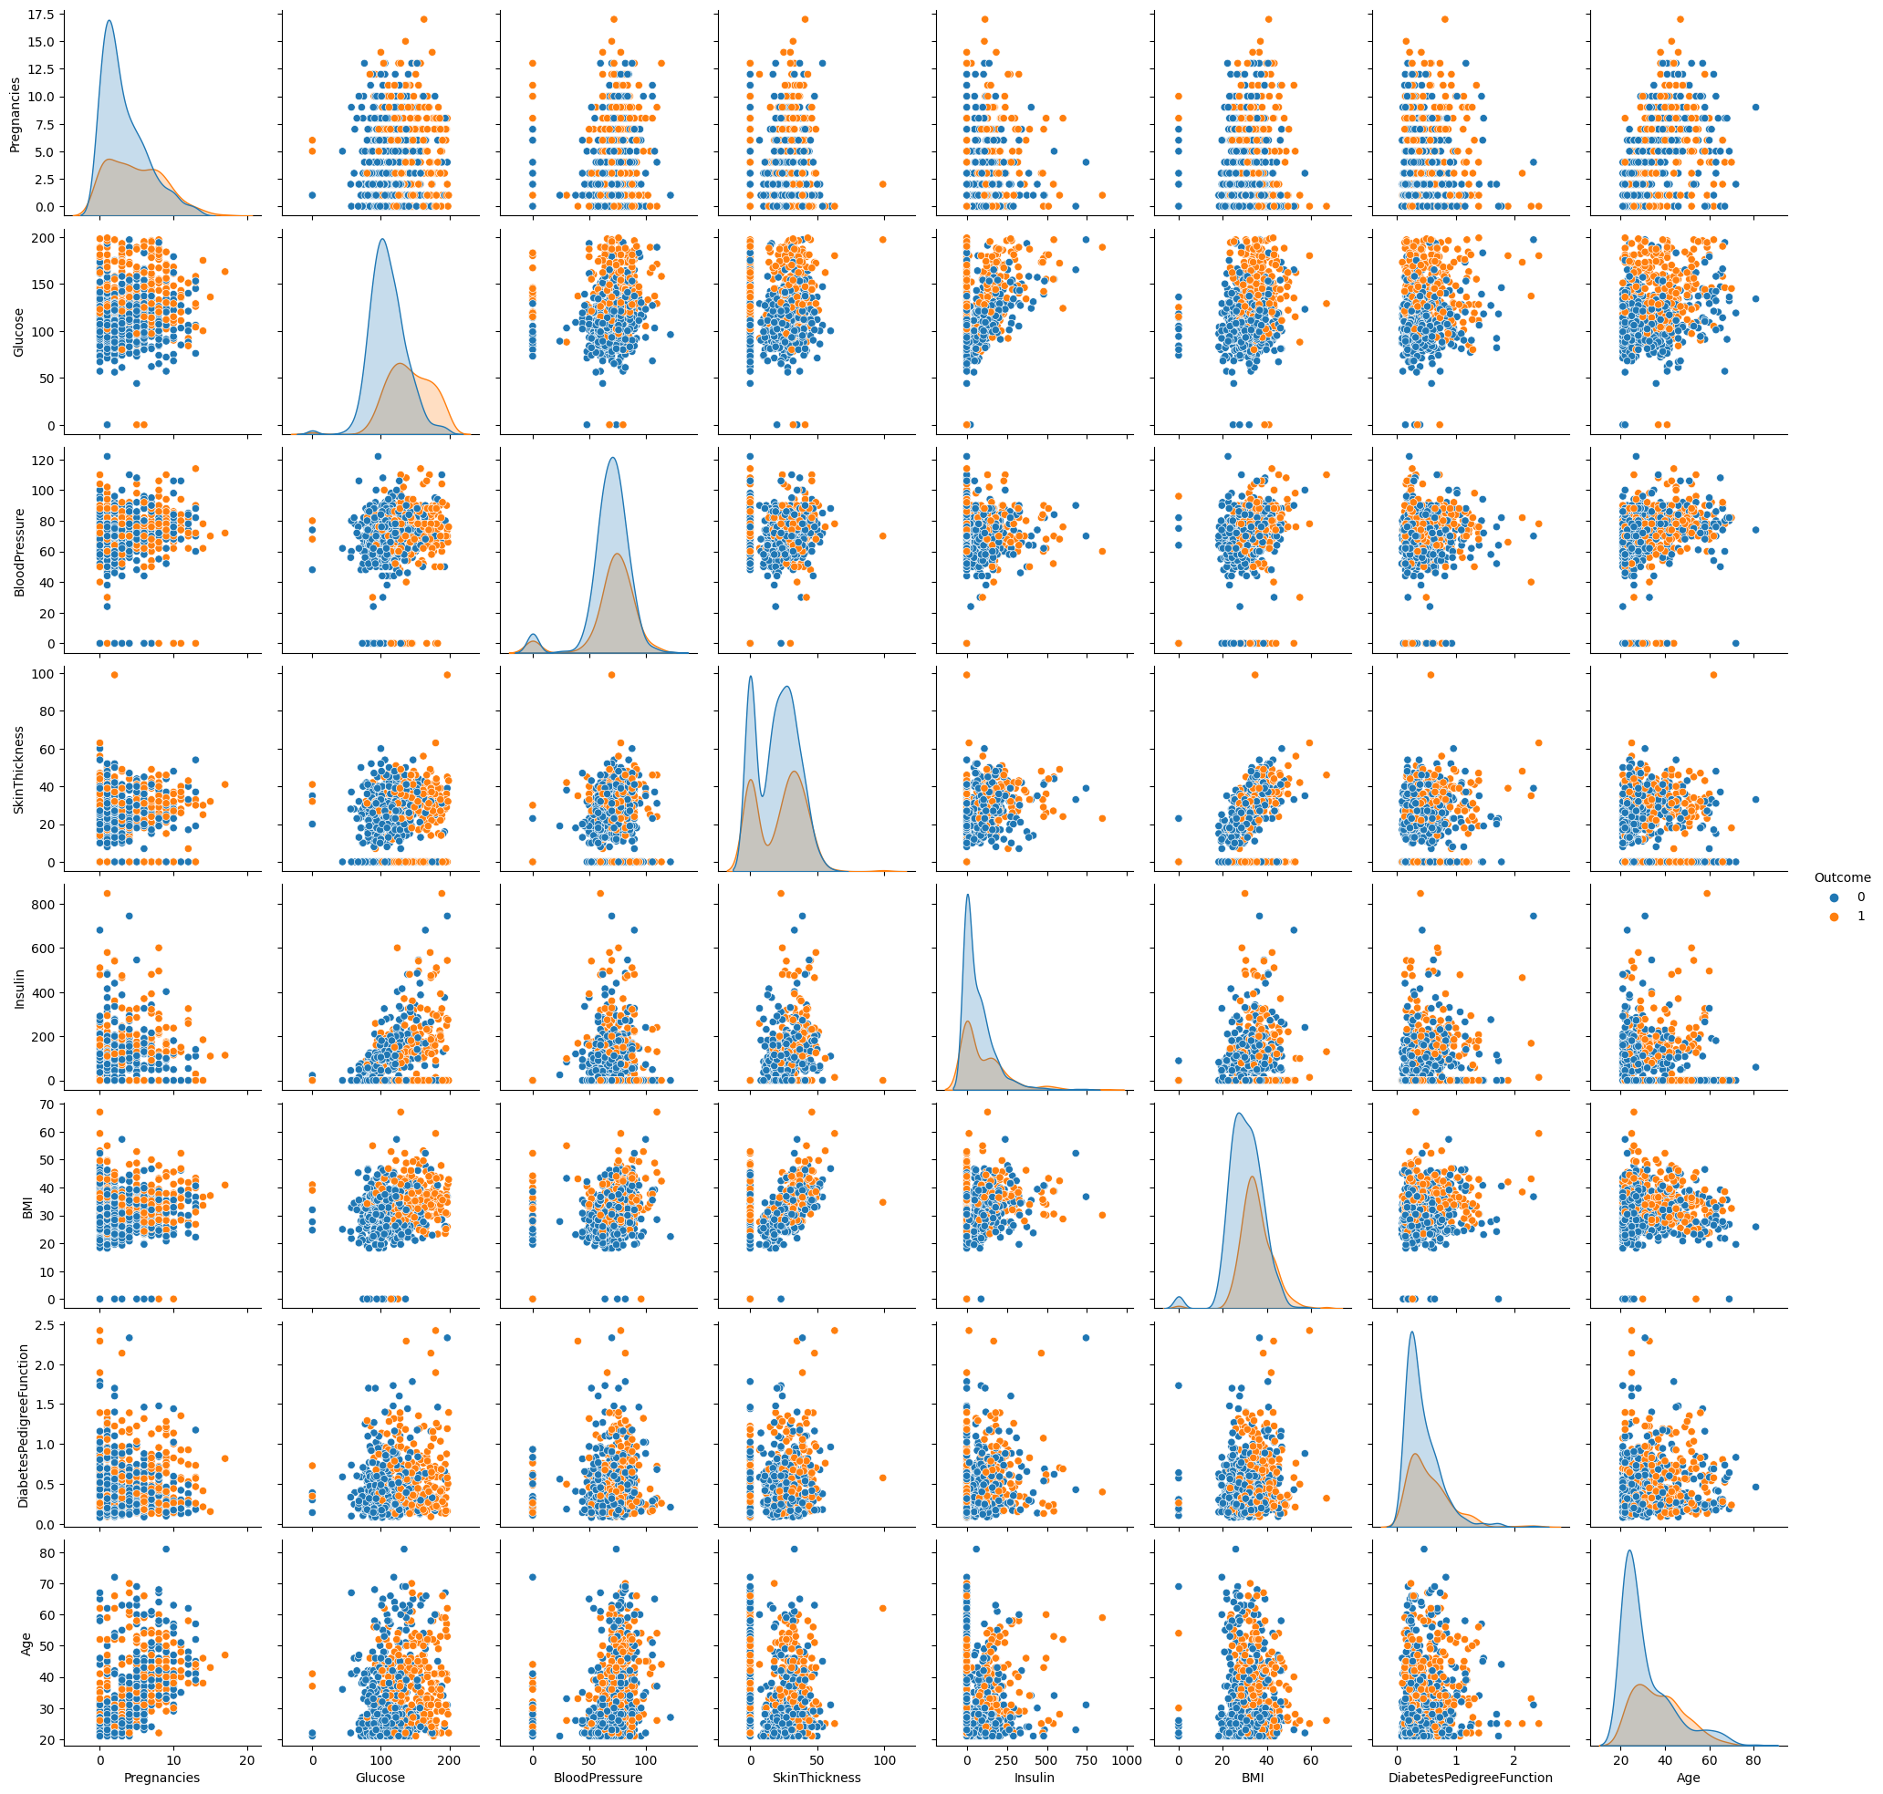

Slide 15
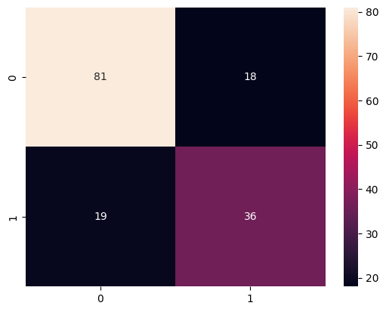
precision recall f1-score support
0 0.81 0.82 0.81 99
1 0.67 0.65 0.66 55

Slide 16
Code-2:
import numpy as np # linear algebra
import pandas as pd # data processing, CSV file I/O (e.g. pd.read_csv)
import matplotlib.pyplot as plt
import seaborn as sns
dataset=pd.read_csv("/kaggle/input/diabetes-data-set/diabetes.csv“)
dataset.head()

Slide 17
Dataset::
Pregnancies | Glucose | Blood Pressure | Skin Thickness | Insulin | Outcome
0 | 6 | 556 | 34.45 | 90.00 | 45.90
1 | 1 | 234 | 56.78 | 848.0 | 09.76
2 | 8 | 865 | 23.89 | 09.8 | 87.78
3 | 1 | 846 | 09.89 | 45.0 | 87.56

Slide 18
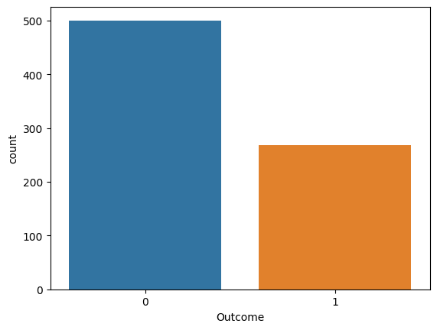
#data visualization
sns.countplot(x = 'Outcome',data = dataset)

Slide 19
# Pairplot
sns.pairplot(data = dataset, hue = 'Outcome')
plt.show()

Slide 20
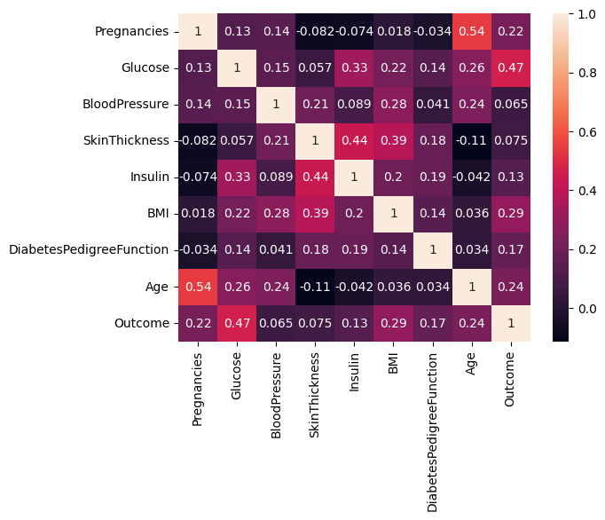
# Heatmap
sns.heatmap(dataset.corr(), annot = True)
plt.show()

Slide 21
# Replacing zero values with NaN
dataset_new = dataset
dataset_new[["Glucose", "BloodPressure", "SkinThickness", "Insulin", "BMI"]] = dataset_new[["Glucose", "BloodPressure", "SkinThickness", "Insulin", "BMI"]].replace(0, np.NaN)
# Count of NaN
dataset_new.isnull().sum()
Pregnancies 0
Glucose 5
BloodPressure 35
SkinThickness 227
Insulin 374
BMI 11
DiabetesPedigreeFunction 0
Age 0
Outcome 0
dtype: int64

Slide 22
# Replacing NaN with mean values
dataset_new["Glucose"].fillna(dataset_new["Glucose"].mean(), inplace = True)
dataset_new["BloodPressure"].fillna(dataset_new["BloodPressure"].mean(), inplace = True)
dataset_new["SkinThickness"].fillna(dataset_new["SkinThickness"].mean(), inplace = True)
dataset_new["Insulin"].fillna(dataset_new["Insulin"].mean(), inplace = True)
dataset_new["BMI"].fillna(dataset_new["BMI"].mean(), inplace = True)
dataset_new.isnull().sum()

Slide 23
Pregnancies 0
Glucose 0
BloodPressure 0
SkinThickness 0
Insulin 0
BMI 0
DiabetesPedigreeFunction 0
Age 0
Outcome 0
dtype: int64

Slide 24
#Logistic regression
y = dataset_new['Outcome']
X = dataset_new.drop('Outcome', axis=1)
# Splitting X and Y
from sklearn.model_selection import train_test_split
X_train, X_test, Y_train, Y_test = train_test_split(X, y, test_size = 0.20, random_state = 42, stratify = dataset_new['Outcome'] )
from sklearn.linear_model import LogisticRegression
model = LogisticRegression()
model.fit(X_train, Y_train)
y_predict = model.predict(X_test)
print(y_predict)

Slide 25
array([1, 0, 0, 0, 0, 0, 0, 1, 0, 1, 0, 0, 0, 0, 0, 0, 1, 0, 1, 0, 0, 1,
0, 1, 0, 0, 1, 0, 0, 0, 0, 0, 0, 1, 1, 0, 0, 0, 1, 1, 0, 0, 0, 0,
0, 0, 0, 0, 1, 0, 0, 1, 0, 0, 0, 0, 1, 0, 1, 0, 1, 0, 0, 1, 0, 0,
1, 0, 0, 1, 0, 0, 0, 1, 0, 1, 0, 1, 0, 0, 0, 0, 0, 0, 0, 0, 0, 0,
0, 0, 1, 1, 0, 0, 0, 1, 1, 1, 1, 0, 0, 0, 0, 0, 1, 0, 1, 0, 1, 1,
0, 1, 0, 0, 0, 0, 0, 0, 1, 0, 1, 0, 0, 1, 0, 1, 1, 1, 0, 0, 0, 1,
0, 1, 1, 0, 0, 0, 0, 0, 0, 0, 0, 0, 0, 0, 0, 1, 0, 0, 0, 0, 1, 0])

Slide 26
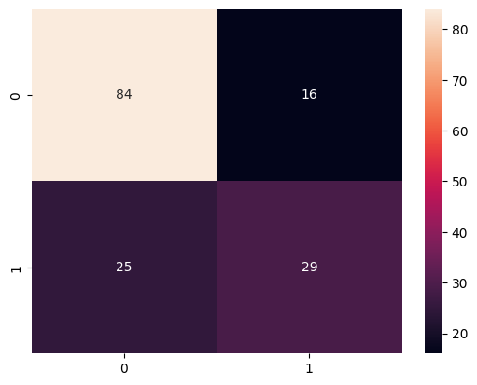
# Confusion matrix
from sklearn.metrics import confusion_matrix
cm = confusion_matrix(Y_test, y_predict)
cm
array([[84, 16],
[25, 29]])
# Heatmap of Confusion matrix
sns.heatmap(pd.DataFrame(cm), annot=True
)

Slide 27
from sklearn.metrics import accuracy_score
accuracy =accuracy_score(Y_test, y_predict)
accuracy
0.7337662337662337
#Example: Let's check whether the person have diabetes or not using some random values
y_predict = model.predict([[1,148,72,35,79.799,33.6,0.627,50]])
print(y_predict)
if y_predict==1:
print("Diabetic")
else:
print("Non Diabetic")

Slide 28
Outcome:-
A sensitivity analysis on USA data proved a 25% relative reduction in diabetes-related complication rates for a 2-year earlier diagnosis. Consequently, many researchers have endeavored to develop predictive models of type 2 diabetes. The first models were based on classic statistical learning techniques, e.g., linear regression.
First, a well-structured, balanced dataset containing different types of features like lifestyle, socioeconomically, and diagnostic data can be created to obtain a good model. Otherwise, complementary techniques can be helpful to clean and balance the data.
The machine learning model will depend on the characteristics of the dataset. When the dataset contains a few observations, machine learning techniques present a better performance; when observations are more than 70,000, Deep Learning has a good performance.

Slide 29
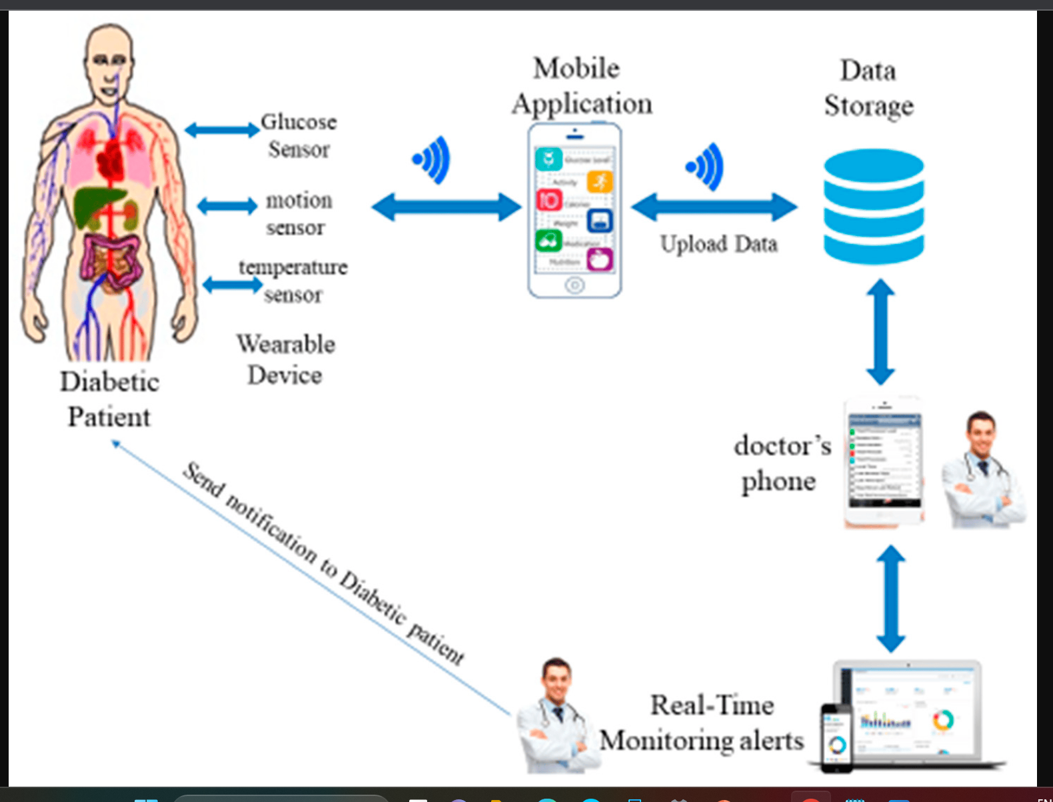

Slide 30
THANK YOU

